Slide 1

CSE 360-Computer Architecture
Special Lecture-MIPS
Dr. Shamim Akhter
Associate Professor
Computer Science and Engineering

Slide 2
Overview of SPIM – the MIPS simulator

Slide 3
Introduction
What is SPIM?
a simulator that runs assembly programs for MIPS R2000/R3000 Reduce Instruction Set Computing-RISC computers
What does SPIM do?
reads MIPS assembly language files and translates to machine language
executes the machine language instructions
shows contents of registers and memory
works as a debugger (supports break-points and single-stepping)
provides basic OS-like services, like simple I/O

Slide 4
MIPS & SPIM Resources
“ Computer Organization & Design: The Hardware/Software Interface”, by Patterson and Hennessy: Chapter 3 and Appendix A.9-10
Other on-line resources

Slide 5
PCSpim Installation
Windows Installation
download the file http://www.cs.wisc.edu/~larus/SPIM/ pcspim.zip and save it on your machine.
unzip the file
run the setup.exe program

Slide 6
Using SPIM
Loading source file
Use File -> Open menu
Simulation
Simulator -> Settings… :
in the Display section check only the first two items Save window
positions and General registers in hexadecimal
in the Execution section check only Allow pseudo instruction
Simulator -> Set Value… : to load PC with address of first instruction
enter Address or Register Name as “PC” and enter Value as “0x00400000”
reason: the text area of memory, where programs are stored, starts here
Simulator -> Go : run loaded program
Click the OK button in the Run Parameters pop-up window if the StartingAddress: value is “0x00400000”
Simulator -> Break : stop execution
Simulator -> Clear Registers and Reinitialize : clean-up before new run
Important!!

Slide 7
Using SPIM
Simulator -> Reload : load file again after editing
Simulator -> Single Step or Multiple Step : stepping to debug
Simulator -> Breakpoints : set breakpoints
Notes:
text segment window of SPIM shows assembly and corresponding machine code
pseudo-instructions each expand to more than one machine instruction
if Load trap file is checked in Simulator -> Settings… then text segment shows additional trap-handling code
if Delayed Branches is checked in Simulator -> Settings… then statementx will execute before control jumps to L1 in following code – to avoid insert nop before statementx:
jal L1
statementx
…
L1: …
nop

Slide 8
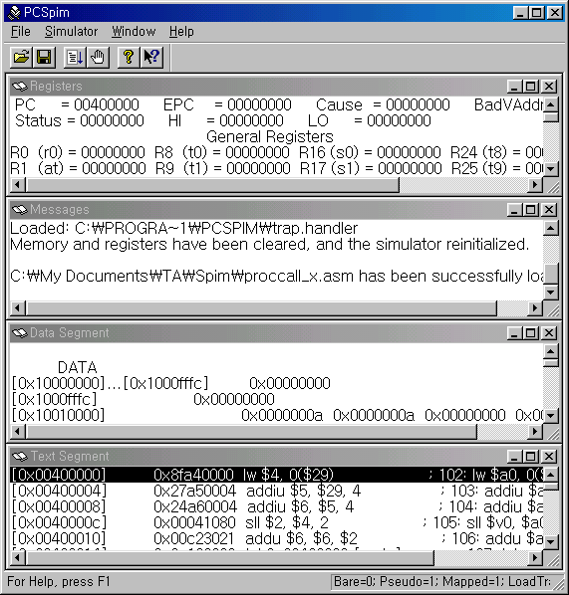
PCSpim Windows Interface
Registers window
shows the values of all registers in the MIPS CPU and FPU
Text segment window
shows assembly instructions & corresponding machine code
Data segment window
shows the data loaded into the program’s memory and the data of the program’s stack
Messages window
shows PCSpim messages
Separate console window appears for I/O

Slide 9
SPIM Example Program: add2numbersProg1.asm
## Program adds 10 and 11
.text # text section
.globl main # call main by SPIM
main:
ori $8,$0,0xA # load “10" into register 8
ori $9,$0,0xB # load “11" into register 9
add $10,$8,$9 # add registers 8 and 9, put result
# in register 10

Slide 10
MIPS Assembly Code Layout
.text #code section
.globl main #starting point: must be global
main:
# user program code
.data #data section
# user program data

Slide 11
MIPS Assembler Directives
Top-level Directives:
.text
indicates that following items are stored in the user text segment, typically instructions
.data
indicates that following data items are stored in the data segment
.globl sym
declare that symbol sym is global and can be referenced from other files

Slide 12
SPIM Example Program: add2numbersProg2.asm
# Program adds 10 and 20
.text # text section
.globl main # call main by SPIM
main:
la $t0, value # load address ‘value’ into $t0
lw $t1, 0($t0) # load word 0(value) into $t1
lw $t2, 4($t0) # load word 4(value) into $t2
add $t3, $t1, $t2 # add two numbers into $t3
sw $t3, 8($t0) # store word $t3 into 8($t0)
.data # data section
value: .word 10, 20, 0 # load data integers. Default data # start address 0x10010000(= value)

Slide 13
MIPS Memory Usage as viewed in SPIM
0x7fffffff
reserved
0x7fffeffc
stack segment
data segment
0x10010000
text segment
(instructions)
0x00400000
reserved
0x00000000

Slide 14
MIPS Assembler Directives
Common Data Definitions:
.word w1, …, wn
store n 32-bit quantities in successive memory words
.half h1, …, hn
store n 16-bit quantities in successive memory halfwords
.byte b1, …, bn
store n 8-bit quantities in successive memory bytes
.ascii str
store the string in memory but do not null-terminate it
strings are represented in double-quotes “str”
special characters, eg. \n, \t, follow C convention
.asciiz str
store the string in memory and null-terminate it

Slide 15
MIPS Assembler Directives
Common Data Definitions:
.float f1, …, fn
store n floating point single precision numbers in successive memory locations
.double d1, …, dn
store n floating point double precision numbers in successive memory locations
.space n
reserves n successive bytes of space
.align n
align the next datum on a 2^{n} byte boundary. For example, .align 2 aligns next value on a word boundary. .align 0 turns off automatic alignment of .half, .word, etc. till next .data directive

Slide 16
MIPS: Software Conventions for Registers
0 zero constant 0
1 at reserved for assembler
2 v0 results from callee
3 v1 returned to caller
4 a0 arguments to callee
5 a1 from caller: caller saves
6 a2
7 a3
8 t0 temporary: caller saves
. . . (callee can clobber)
15 t7
16 s0 callee saves
. . . (caller can clobber)
23 s7
24 t8 temporary (cont’d)
25 t9
26 k0 reserved for OS kernel
27 k1
28 gp pointer to global area
29 sp stack pointer
30 fp frame pointer
ra return Address (HW):
caller saves

Slide 17
SPIM System Calls
System Calls (syscall)
OS-like services
Method
load system call code into register $v0 (see following table for codes)
load arguments into registers $a0, …, $a3
call system with SPIM instruction syscall
after call return value is in register $v0, or $f0 for floating point results

Slide 18
SPIM System Call Codes
Service | Code (put in $v0) | Arguments | Result
print_int | 1 | $a0=integer
print_float | 2 | $f12=float
print_double | 3 | $f12=double
print_string | 4 | $a0=addr. of string
read_int | 5 |  | int in $v0
read_float | 6 |  | float in $f0
read_double | 7 |  | double in $f0
read_string | 8 | $a0=buffer, $a1=length
sbrk | 9 | $a0=amount | addr in $v0
exit | 10

Slide 19
SPIM Example Program: systemCalls.asm
lw $t1, 0($t0)
lw $t2, 4($t0)
add $t3, $t1, $t2
sw $t3, 8($t0)
li $v0, 4
la $a0, msg1
syscall
li $v0, 1
move $a0, $t3
syscall
li $v0, 10
syscall
.data
value: .word 0, 0, 0
msg1: .asciiz “Sum = “
## Enter two integers in
## console window
## Sum is displayed
.text
.globl main
main:
la $t0, value
li $v0, 5
syscall
sw $v0, 0($t0)
li $v0, 5
syscall
sw $v0, 4($t0)
system call code
for print_string
argument to print_string call
system call code
for print_int
system call code
for read_int
argument to print_int call
system call code
for exit
result returned by call

Slide 20
Procedures
Example C code:
// procedure adds 10 to input parameter
int main()
{ int i, j;
i = 5;
j = add10(i);
i = j;
return 0;
}
int add10(int i)
{ return (i + 10);}

Slide 21
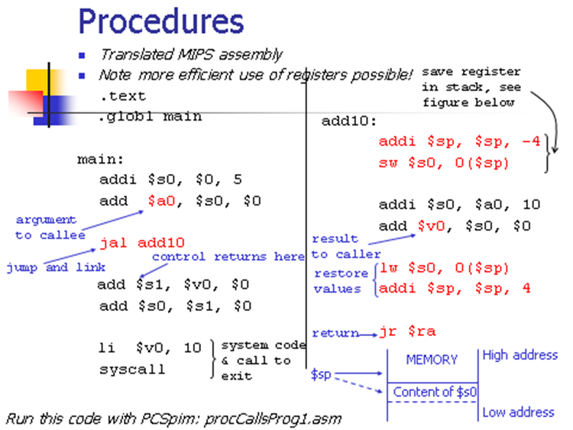
Procedures
save register
in stack, see
figure below
Translated MIPS assembly
Note more efficient use of registers possible!
.text
.globl main
main:
addi $s0, $0, 5
add $a0, $s0, $0
jal add10
add $s1, $v0, $0
add $s0, $s1, $0
li $v0, 10
syscall
add10:
addi $sp, $sp, -4
sw $s0, 0($sp)
addi $s0, $a0, 10
add $v0, $s0, $0
lw $s0, 0($sp)
addi $sp, $sp, 4
jr $ra
argument
to callee
result
to caller
control returns here
jump and link
restore
values
return
system code
& call to
exit
MEMORY
High address
$sp
Content of $s0
Run this code with PCSpim: procCallsProg1.asm
Low address

Slide 22
Procedures (recursive)
Example C code – recursive factorial subroutine:
int main()
{ int i;
i = 4;
j = fact(i);
return 0;}
int fact(int n)
{ if (n < 1) return (1);
else return ( n*fact(n-1) );}

Slide 23
Procedures (recursive)
Translated MIPS assembly:
.text
.globl main
main:
addi $a0, $0, 4
jal fact
nop
move $a0, $v0
li $v0, 1
syscall
li $v0, 10
syscall
fact:
addi $sp, $sp, -8
sw $ra, 4($sp)
sw $a0, 0($sp)
slti $t0, $a0, 1
beq $t0, $0, L1
nop
addi $v0, $0, 1
addi $sp, $sp, 8
jr $ra
L1:
addi $a0, $a0, -1
jal fact
nop
lw $a0, 0($sp)
lw $ra, 4($sp)
addi $sp, $sp, 8
mul $v0, $a0, $v0
jr $ra
branch to
L1 if n>=1
control
returns
from fact
return 1
if n < 1
print value
returned by
fact
if n>=1 call
fact recursively
with argument
n-1
exit
restore return
address, argument,
and stack pointer
save return
address and
argument in
stack
return
n*fact(n-1)
return control

Slide 24
Using a Frame Pointer
Variables that are local to a procedure but do not fit into registers (e.g., local arrays, struc-
tures, etc.) are also stored in the stack. This area of the stack is the frame. The frame pointer
$fp points to the top of the frame and the stack pointer to the bottom. The frame pointer does
not change during procedure execution, unlike the stack pointer, so it is a stable base
register from which to compute offsets to local variables.
Use of the frame pointer is optional. If there are no local variables to store in the stack it is
not efficient to use a frame pointer.

